Slide 1



MSU Maximum Powerpoint Tracker
Technical Presentation:
Solar Arrays
Team 8
Jacob Mills
Luis Kalaff
Daniel Chen
Yue Guo
Brenton Sirowatka

Slide 2
Outline
Background: Solar Energy
History
Applications
How Solar Cells Works
How it relates to a MPPT

Slide 3
Background: Solar Energy
Solar energy is radiant light and heat from the sun harnessed using a range of ever-evolving technologies such as solar heating, solar photovoltaics, solar thermal electricity, solar architecture and artificial photosynthesis.
"The development of affordable, inexhaustible and clean solar energy technologies will have huge longer-term benefits. It will increase countries’ energy security through reliance on an indigenous, inexhaustible and mostly import-independent resource, enhance sustainability, reduce pollution, lower the costs of mitigating climate change, and keep fossil fuel prices lower than otherwise.”------ The International Energy Agency, 2011

Slide 4
Comparison of Solar Energy
And Other Energy Sources

Slide 5
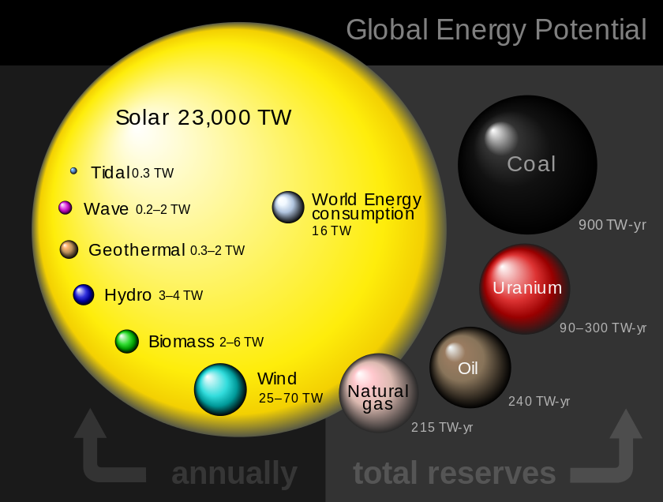

Slide 6
Solar Arrays:
Devices To Collect Solar Energy

Slide 7
History
The photovoltaic effect was first observed by a French physicist, Alexandre Bacquerel, in 1839.
American Inventor, Charles Fritts, makes first solar cell made from selenium wafers with 1% efficiency in 1883.
Albert Einstein publishes theory on “photoelectric effect” in 1905, and later proved experimentally by Robert Millikan in 1916.
Bell Labs makes first high power silicon PV cell with 6% efficiency in 1954.
Currently, Fraunhofer manufacturers the highest efficiency cells with 44.7% efficiency.
In 2012, first 3D solar cells produced by Solar3D.

Slide 8
Applications

Slide 9
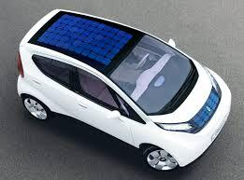
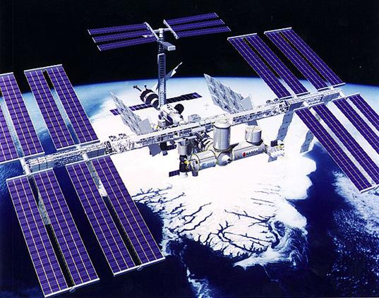
Types of Applications
Solar Power Applications:
Transportation (Cars, Buses, Trains)
Household (Pools, Landscaping)
Space (Satellites, ISS)
Portable (Calculators)
Power Grid (Solar Farms, household
installations)

Slide 10
Lifespan and Aging
Need to withstand environment
  Requires encapsulation to prevent rusting
  Usually put in module with protective glass to prevent physical damage
Power Output degrades approximately 0.5% per year.
Different types of cells degrade at different rates.
Most warranties guarantee last 25 years with 80% power output.

Slide 11
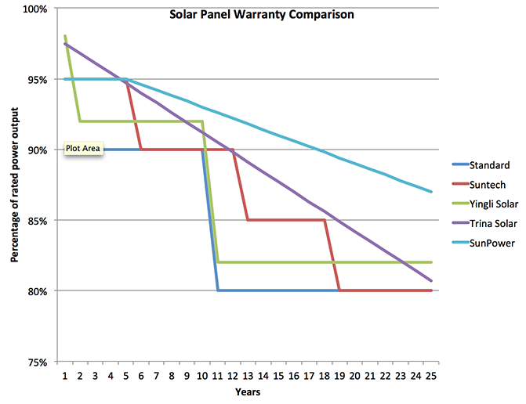
Lifespan and Aging

Slide 12
Pricing Through History
Solar panel Prices are declining
Usually priced per Watt.
Today an average solar panel will cost less than a dollar per Watt

Slide 13
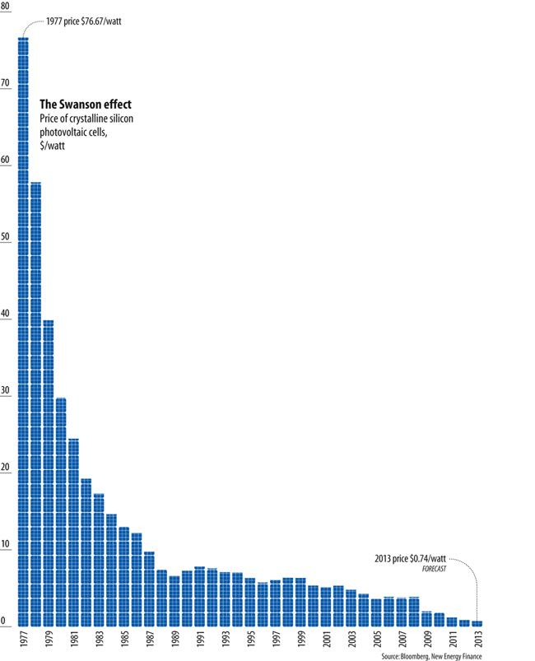
Pricing Through History

Slide 14
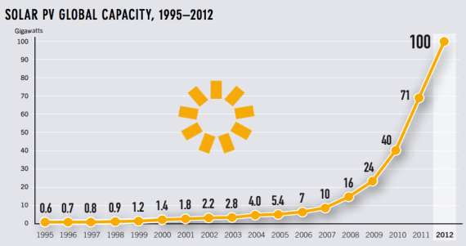
Watts Produced Through History

Slide 15
How Solar Cells Work

Slide 16
The Photovoltaic Effect
Creation of voltage and current in a material in response to light.
Electrons in valence band of material absorb energy.
Highly excited electrons breakfree, and diffuse to different material.
Light energy to Electrical Energy

Slide 17
Photovoltaic Effect in Panels
We use the photovoltaic effect to our advantage with solar panels.
  mounted in high sunlight
  protection of elements
  Connected to device using non-magnetic conductive materials

Slide 18
Configuration of Cells
Add their voltage in series
Add their current in parallel.
Low open circuit voltage (~.5V*) and
High short circuit current (~6A max*)
*Example spec for Sunpower C60 Solar cells

Slide 19
Types of Cells
There are many (>20) types
Monocrystalline
Multijunction
Organic
Polychrystalline
etc

Slide 20
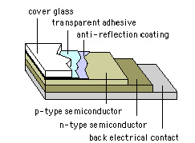
Anatomy
http://nanosense.sri.com/activities/cleanenergy/solarcellanimation.html

Slide 21
The p-n Junction
Most common cell uses p-n configuration
P-type silicon and N-Type Silicon are brought together inside the cell.
N-type has many electrons while p-type has less electrons and more holes.
When the electrons diffuse they recombine with holes in the p-type side.

Slide 22
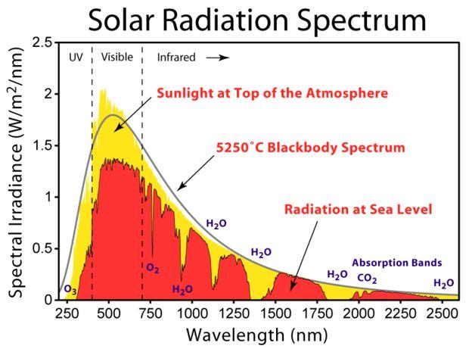
Spectrum
of Light
http://commons.wikimedia.org/wiki/File:Solar_Spectrum.png

Slide 23

Efficiency
Ratio of output energy and energy from sun
Terrestrial solar cell at AM1.5
Spatial solar cell at AM0
http://pveducation.org/pvcdrom/solar-cell-operation/fill-factor

Slide 24
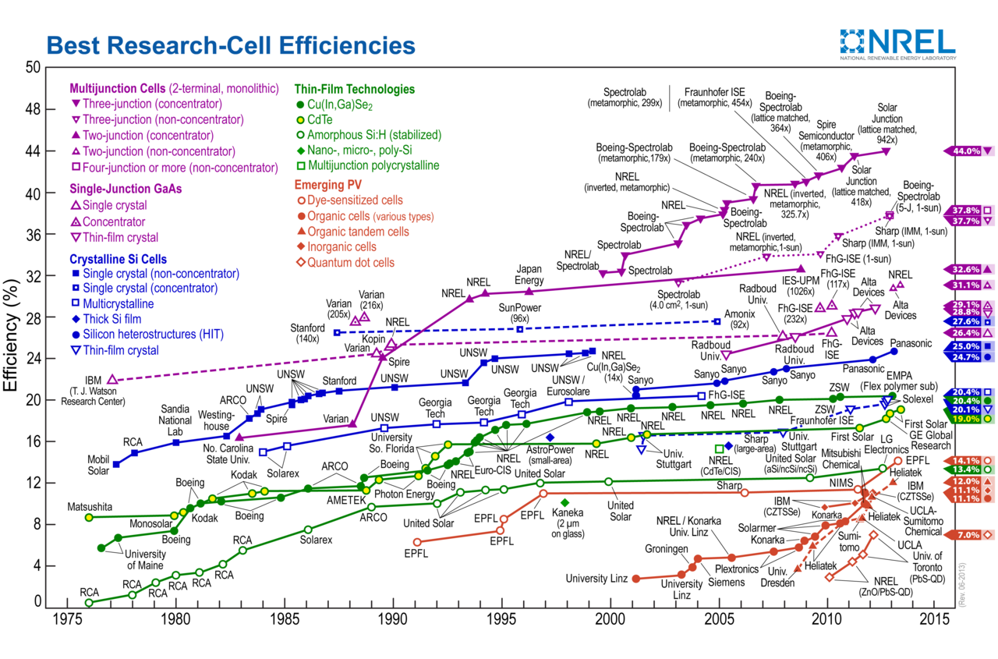

Slide 25
Energy Loss
If a photon doesn’t have enough energy to alter an electron-hole pair, it will pass through.
If a photon has too much energy, energy is lost.
The ‘band gap energy’ of a material determines the amount of energy to knock an electron loose.
http://science.howstuffworks.com/environmental/energy/solar-cell4.htm

Slide 26

Equivalent Circuit

Slide 27
Characteristic Equation
I = output current
I_{L} = photogenerated current (ampere)
I_{D} = diode current (ampere)
I_{SH} = shunt current (ampere).

Slide 28
Characteristic Equation
V_{j} = voltage across both diode and resistor R_{SH}
V = voltage across the output terminals
I = output current
R_{S} = series resistance

Slide 29

Shockley Diode Equation
I₀ = reverse saturation current (ampere)
n = diode ideality factor (1 for an ideal diode)
q = elementary charge
k = Boltzmann's constant
T = absolute temperature
At 25°C, kT/q = 0.0259 volt.

Slide 30
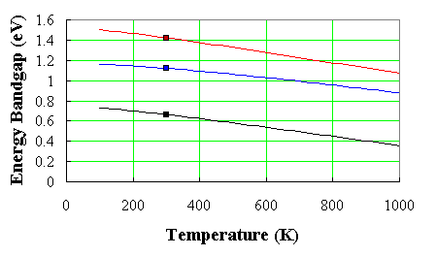
Temperature Response
Temperature Band Gap
Band Gap Bond Energy
germanium, silicon and gallium arsenide

Slide 31
How it Relates to a MPPT
A solar cell’s voltage and current is dependent upon temperature, incident light per area, and photon energy. On a solar car, these factors can change drastically, making it difficult to get the maximum power out. A MPPT helps solve this problem.

Slide 32
Resources
http://science.howstuffworks.com/environmental/energy/solar-cell.htm
http://www.solarworld-usa.com/solar-101/how-solar-panels-work
http://energyinformative.org/lifespan-solar-panels/
http://cleantechnica.com/2014/09/04/solar-panel-cost-trends-10-charts/
http://costofsolar.com/management/uploads/2013/07/Best_Research-Cell_Efficiencies.png
http://nanosense.sri.com/activities/cleanenergy/solarcellanimation.html
http://commons.wikimedia.org/wiki/File:Solar_Spectrum.png
http://pveducation.org/
http://ecee.colorado.edu/~bart/book/eband5.htm

Slide 33
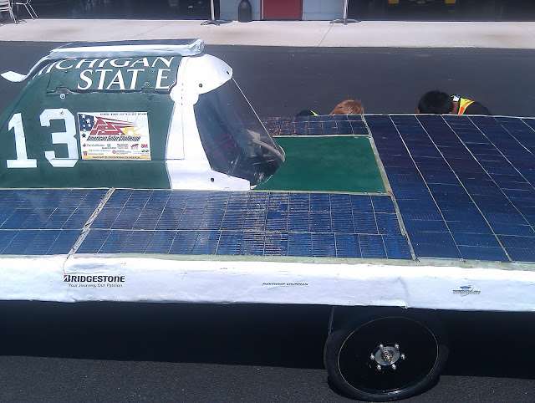
Questions?

